Slide 1
React + Redux
Philip Falkenberg
Last Updated: 10/31/17

Slide 2
What is Redux?
Redux is a design pattern that allows efficient and predictable state management in an application.
It is language/framework agnostic. Works in vanilla JS, Angular, or React.
It uses unidirectional data flow to change and update the UI.

Slide 3
Redux Design Principles
Actions
Reducers
Single Store for State
Dispatcher
Three Principles
Single Source of truth
State is read-only
Changes are made with pure functions

Slide 4
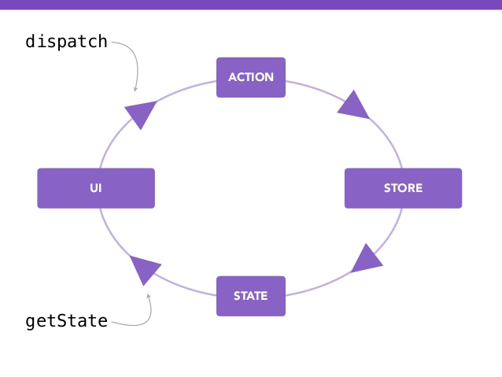
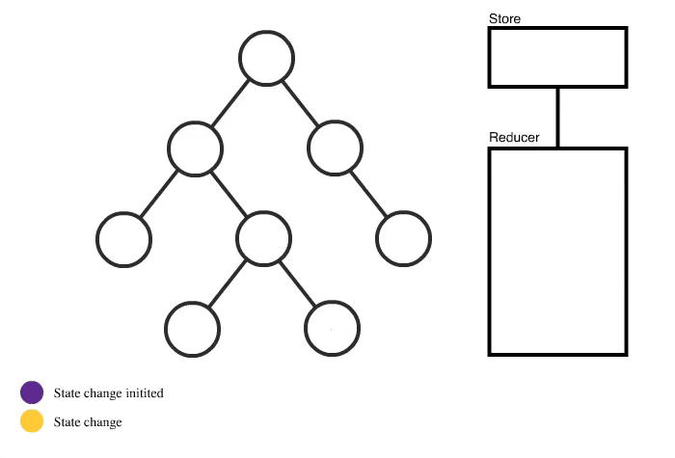
Redux Visualization

Slide 5
Redux Time Travel
0s
30s
STORE
isOn: false
STORE
isOn: true
STORE
isOn: false
View
Switch: TOGGLE()
Action Data Stack
Action: TOGGLE, isOn: false
ACTION
DISPATCH
REDUCER
Action: TOGGLE, isOn: true
Action: TOGGLE, isOn: false

Slide 6
References
https://medium.com/dailyjs/when-do-i-know-im-ready-for-redux-f34da253c85f
http://redux.js.org/
https://swizec.com/blog/animating-with-react-redux-and-d3/swizec/6775
https://redux-minimal.js.org/
https://code.tutsplus.com/tutorials/introduction-to-webpack-part-1--cms-25791
https://medium.com/@rajaraodv/webpack-the-confusing-parts-58712f8fcad9

